Slide 1
Informed Search
Md Mehrab Hossain Opi
CSE 4109: Artificial Intelligence

Slide 2
Informed Search
Informed Search algorithms use problem-specific knowledge (called a heuristic) to make better decision about which path to follow toward the goal.

Slide 3
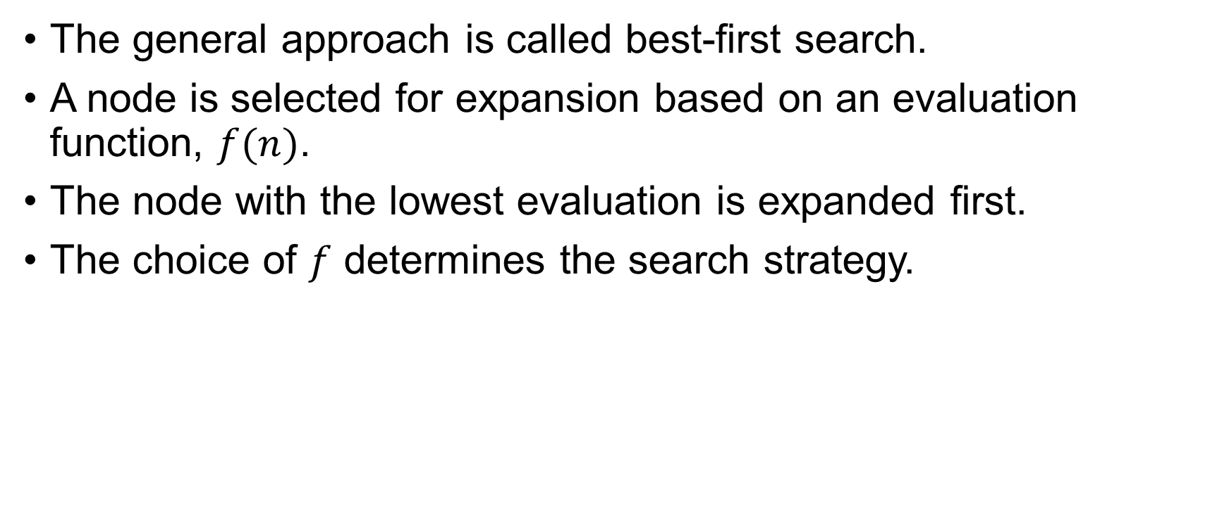
Best-First Search
The general approach is called best-first search.
A node is selected for expansion based on an evaluation function, $f(n)$.
The node with the lowest evaluation is expanded first.
The choice of $f$ determines the search strategy.

Slide 4

Heuristic Function
Most best-first search algorithms include as a component of $f$ a heuristic function, denoted $h(n)$.
$$h\left(n\right)=estimated cost of the cheapest path from the state at a node n to a goal state.$$

Slide 5

Greedy Best-First Search
Greedy best-first search selects the node that appears to be closest to the goal, based on the heuristic function $h(n)$ only.
Let’s understand this with the maze problem.

Slide 6
Greedy Best First Search
Consider the following maze.
The agent wants to go to cell B from the cell A.
Our target is to find the shortest path.
 |  |  |  |  |  |  |  |  |  |  | B
A

Slide 7
Greedy Best First Search
Between C and D which point will lead us to B faster?
 |  |  |  |  |  |  |  |  |  |  | B
 |  |  |  |  |  |  | D
 | C
A

Slide 8


Greedy Best First Search
Let’s consider the Manhattan distance.
We will use this as the heuristic function.
$$h\left(C\right)=13$$
 |  |  |  |  |  |  |  |  |  |  | B
 |  |  |  |  |  |  | D
 | C
A
$h\left(D\right)=$6

Slide 9

Greedy Best First Search
Let’s find the $h(n)$ for all the cells.
11 |  | 9 |  | 7 |  |  |  | 3 | 2 |  | B
12 |  | 10 |  | 8 | 7 | 6 |  | 4 |  |  | 1
13 | 12 | 11 |  | 9 |  | 7 | 6 | 5 |  |  | 2
 | 13 |  |  | 10 |  | 8 |  | 6 |  |  | 3
 | 14 | 13 | 12 | 11 |  | 9 |  | 7 | 6 | 5 | 4
 |  |  | 13 |  |  | 10
A | 16 | 15 | 14 |  |  | 11 | 10 | 9 | 8 | 7 | 6

Slide 10
Greedy Best First Search
11 |  | 9 |  | 7 |  |  |  | 3 | 2 |  | B
12 |  | 10 |  | 8 | 7 | 6 |  | 4 |  |  | 1
13 | 12 | 11 |  | 9 |  | 7 | 6 | 5 |  |  | 2
 | 13 |  |  | 10 |  | 8 |  | 6 |  |  | 3
 | 14 | 13 | 12 | 11 |  | 9 |  | 7 | 6 | 5 | 4
 |  |  | 13 |  |  | 10
A | 16 | 15 | 14 |  |  | 11 | 10 | 9 | 8 | 7 | 6

Slide 11
Greedy Best First Search
Now, let’s apply the same algorithm on the following maze.
Is it the shortest path?
 | 10 | 9 | 8 | 7 | 6 | 5 | 4 | 3 | 2 | 1 | B
 | 11 |  |  |  |  |  |  |  |  |  | 1
 | 12 |  | 10 | 9 | 8 | 7 | 6 | 5 | 4 |  | 2
 | 13 |  | 11 |  |  |  |  |  | 5 |  | 3
 | 14 | 13 | 12 |  | 10 | 9 | 8 | 7 | 6 |  | 4
 |  |  | 13 |  | 11 |  |  |  |  |  | 5
A | 16 | 15 | 14 |  | 12 | 11 | 10 | 9 | 8 | 7 | 6
Cost = 33

Slide 12
Greedy Best First Search
 | 10 | 9 | 8 | 7 | 6 | 5 | 4 | 3 | 2 | 1 | B
 | 11 |  |  |  |  |  |  |  |  |  | 1
 | 12 |  | 10 | 9 | 8 | 7 | 6 | 5 | 4 |  | 2
 | 13 |  | 11 |  |  |  |  |  | 5 |  | 3
 | 14 | 13 | 12 |  | 10 | 9 | 8 | 7 | 6 |  | 4
 |  |  | 13 |  | 11 |  |  |  |  |  | 5
A | 16 | 15 | 14 |  | 12 | 11 | 10 | 9 | 8 | 7 | 6
Cost = 21

Slide 13
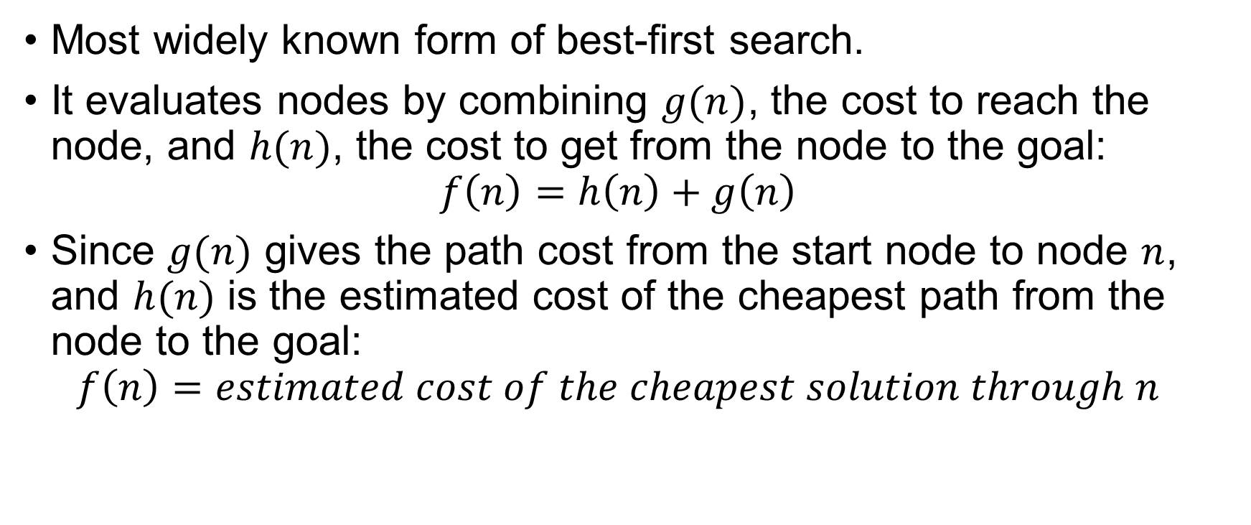
A*-Search
Most widely known form of best-first search.
It evaluates nodes by combining $g(n)$, the cost to reach the node, and $h(n)$, the cost to get from the node to the goal:
$f\left(n\right)=h\left(n\right)+g\left(n\right)$
Since $g(n)$ gives the path cost from the start node to node $n$, and $h(n)$ is the estimated cost of the cheapest path from the node to the goal:
$f\left(n\right)=estimated cost of the cheapest solution through n$

Slide 14
A*-Search
10+11
9+12
8+13
7+14
5+16
3+18
2+19
1+20
 | 10 | 9 | 8 | 7 | 6 | 5 | 4 | 3 | 2 | 1 | B
 | 11 |  |  |  |  |  |  |  |  |  | 1
 | 12 |  | 10 | 9 | 8 | 7 | 6 | 5 | 4 |  | 2
 | 13 |  | 11 |  |  |  |  |  | 5 |  | 3
 | 14 | 13 | 12 |  | 10 | 9 | 8 | 7 | 6 |  | 4
 |  |  | 13 |  | 11 |  |  |  |  |  | 5
A | 16 | 15 | 14 |  | 12 | 11 | 10 | 9 | 8 | 7 | 6
6+15
4+17
11+10
12+9
10+7
9+8
8+9
7+10
6+11
5+12
4+13
13+8
11+6
5+14
14+7
13+6
12+5
13+4
16+1
15+2
14+3

Slide 15
Greedy Best First Search/ A* Search
GreedyBestFirstSearch(problem):
node := create_node(problem.initial_state,
parent =null, action = null, path_cost = 0)
frontier := PriorityQueue ordered by h(n)
frontier.insert(node,f(node.state))
explored := empty set
while frontier is not empty:
node := frontier.pop()
if problem.is_goal(node.state):
return solution_path(node)
explored.add(node.state)
for each action in problem.actions(node.state):
child_state := problem.result(node.state,action)
step_cost := problem.step_cost(node.state, action,
child_state)
child_node := create_node(child_state,
parent=node, action = action,
path_cost = node.path_cost + step_cost)
if child_state not in explored and not in frontier:
f_value := f(child_state)
frontier.insert(child_node, f_value)
return failure

Slide 16
Thank You.

